Slide 1
Color Scales
Team 7
Objectives
Topics
Resources
To Understand how the concept of Color scales are important for Data visualisations, how the use of different color pallets can be interpreted as a powerful tool by itself, based on the information we need from the data we choose.
Color as a tool to distinguish
Color to represent Data Values.
Color as a tool to highlight
This is a list of resources which we referred to build this presentation.
Slidesmania.com
Course Textbook
Lecture Slides
Quote
The Greatest Value of a Picture is when it forces us to notice what we never expected to see - John W Tukey

Slide 2
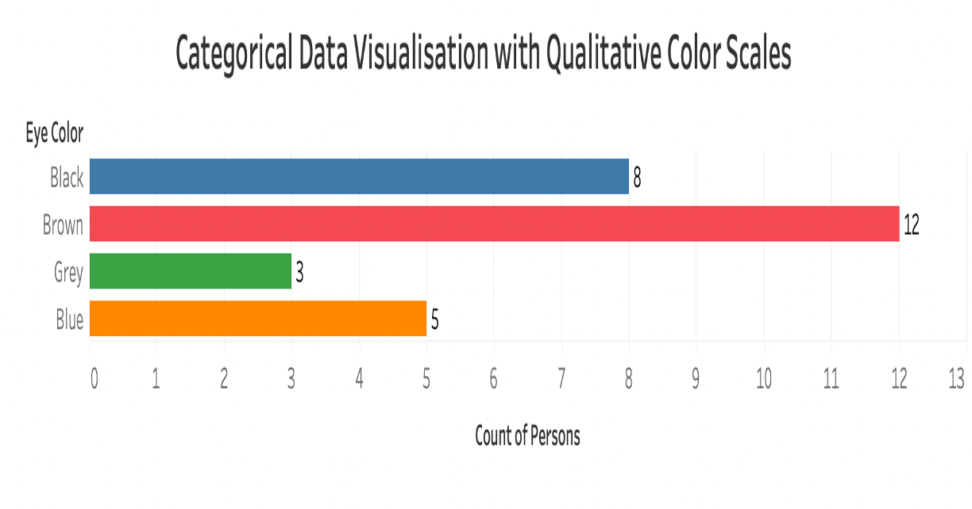
Qualitative Color Scales
Color as a tool to distinguish
This type of color scales are used to represent any type of data that are Distinct and Unordered.
All the colors in the below chart are distinct from each other representing unique eye color categories.
All the colors in the below chart does not show any kind of order with respect to each category.
All the colors used in this particular context has similar level of importance for each category.

Slide 3
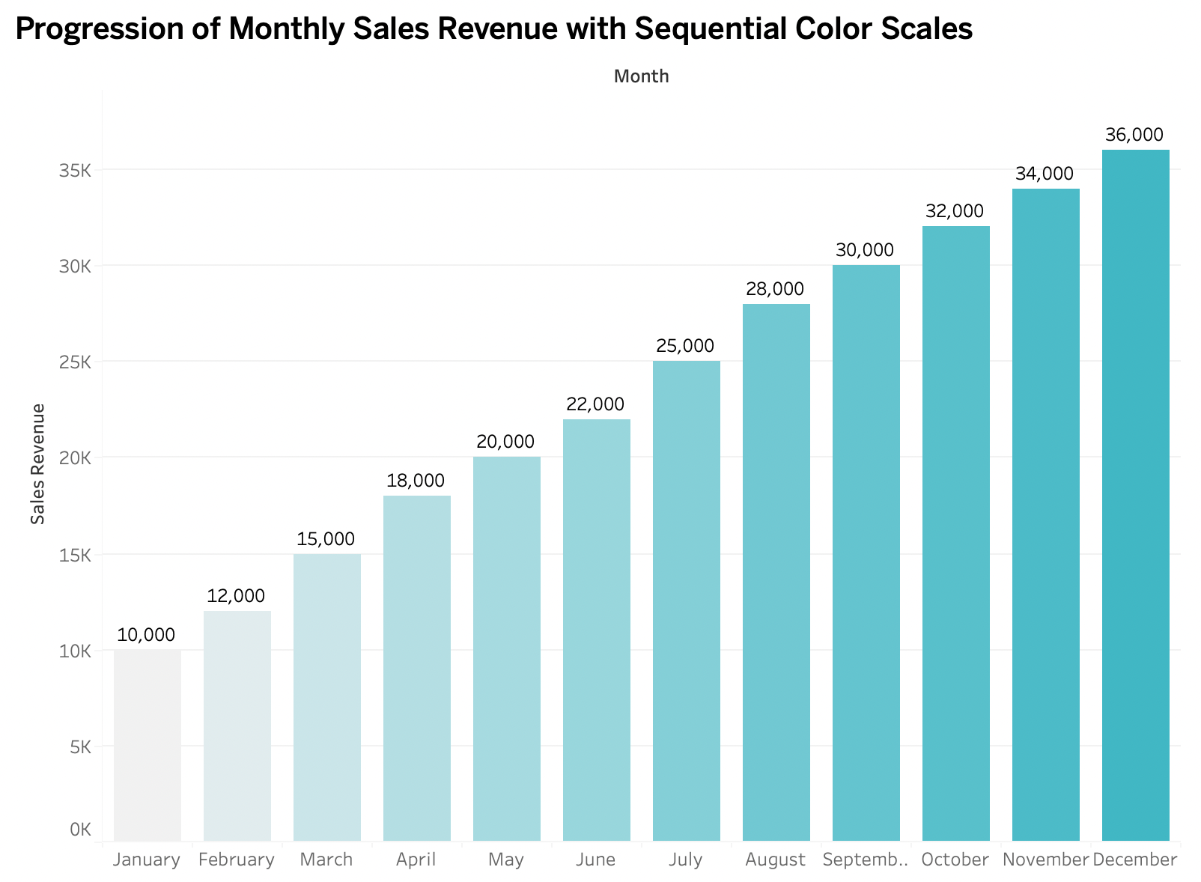
Sequential Color Scales
Color to Represent Data Values
Colors can also be used to represent data values, such as income, temperature or speed.
The sequence of colors clearly indicate:
-which values are larger or smaller than the others.
-How distant two specific values are from each other
The highest monthly sales revenue is that of month December which also is the darkest color in the plot and the lowest is January for which the color is the lightest.

Slide 4
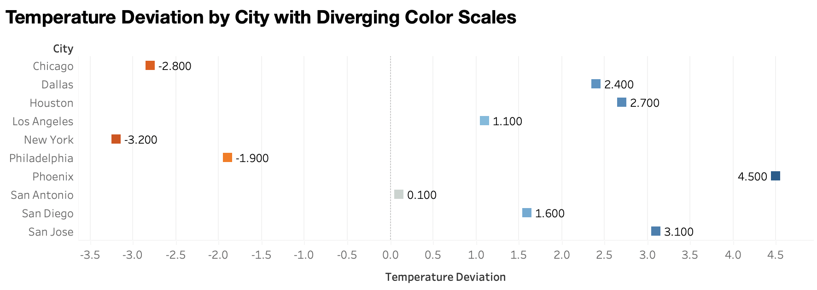
Divergent Color Scales
Color to Represent Data Values
Inorder to visualize the deviation of data values in one of two directions relative to neutral midpoint- we use Divergent Color Scales.
The highest deviation is that of Phoenix and the lowest is San Antonio, the colors are respectively dark and light.

Slide 5
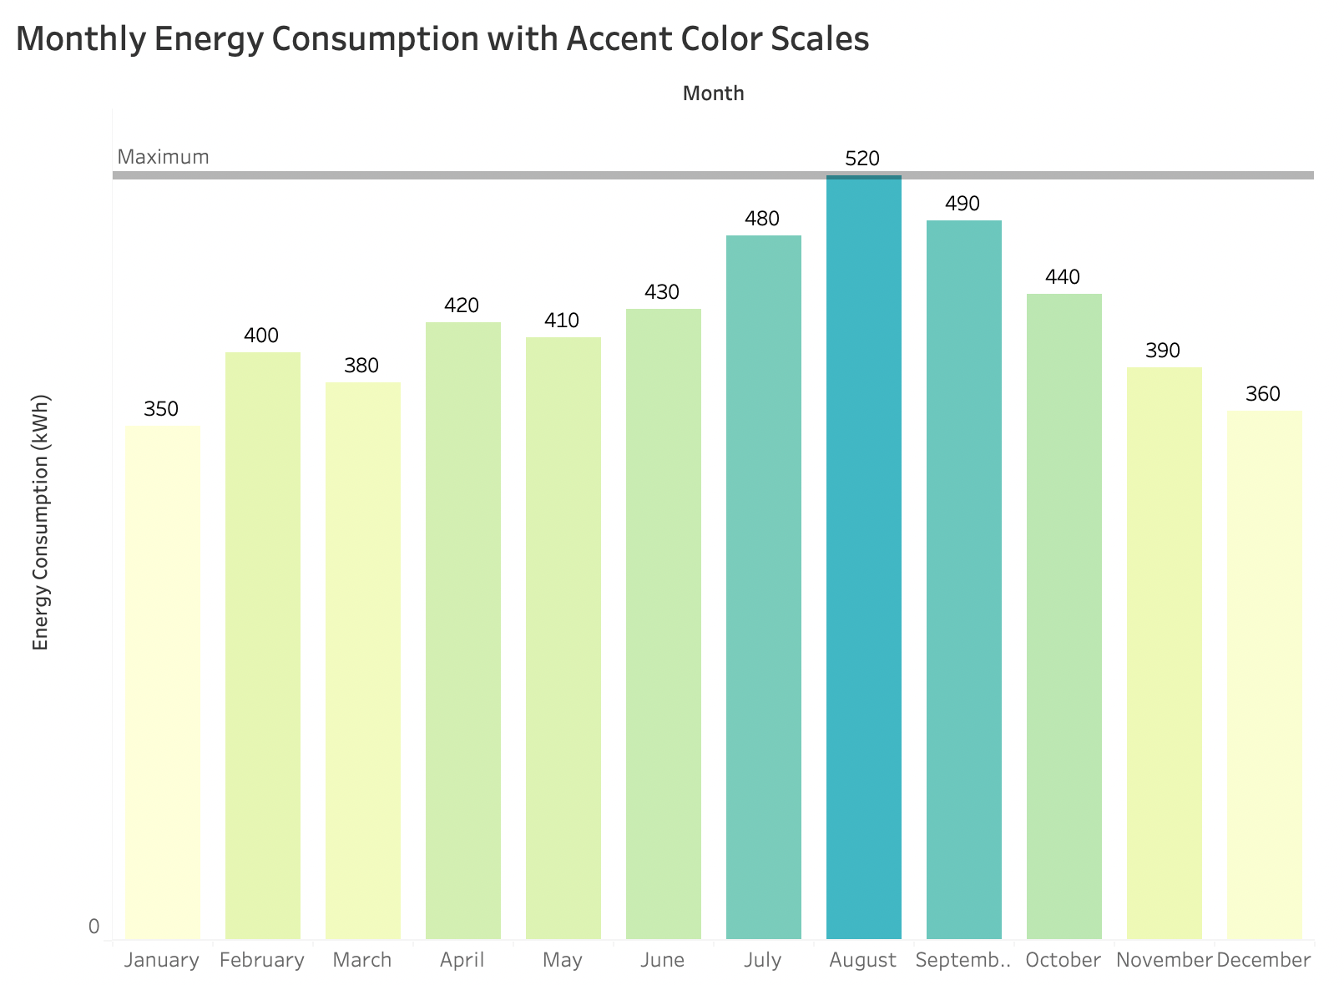
Accent Color Scales
Color as a tool to Highlight
There may be specific categories or values in the dataset that carry key information - to emphasize the relevant figure elements to the reader.
It is critical that the baseline colors do not compete for attention.
The highest monthly energy consumption is that of August and is highlighted in blue, it catches our attention instantly.

Slide 6
Directory of Visualizations
Group 7
Objectives
Resources
Topics
To choose a visualization based on the type of data we are looking at, and based on the insight we tend to pull out of it using the right dimensions, and metrics.
This is a list of resources which we referred to build this presentation.
Slidesmania.com
wikipedia
Course Textbook
Lecture Slides
Amounts
Distributions
Proportions
x-y relationships
Geospatial Data
Uncertainty
Quote
The Purpose of Visualization is insight, not pictures.
- Ben Shneiderman

Slide 7
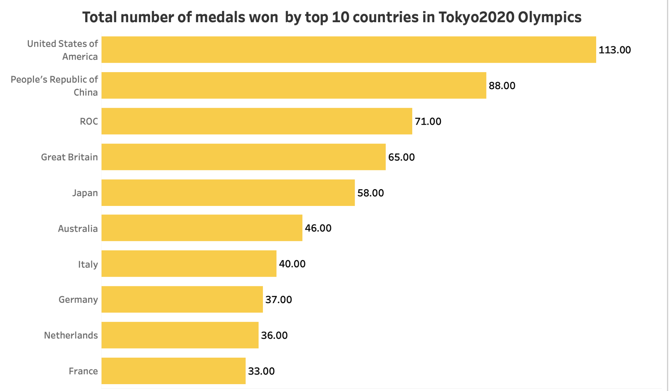
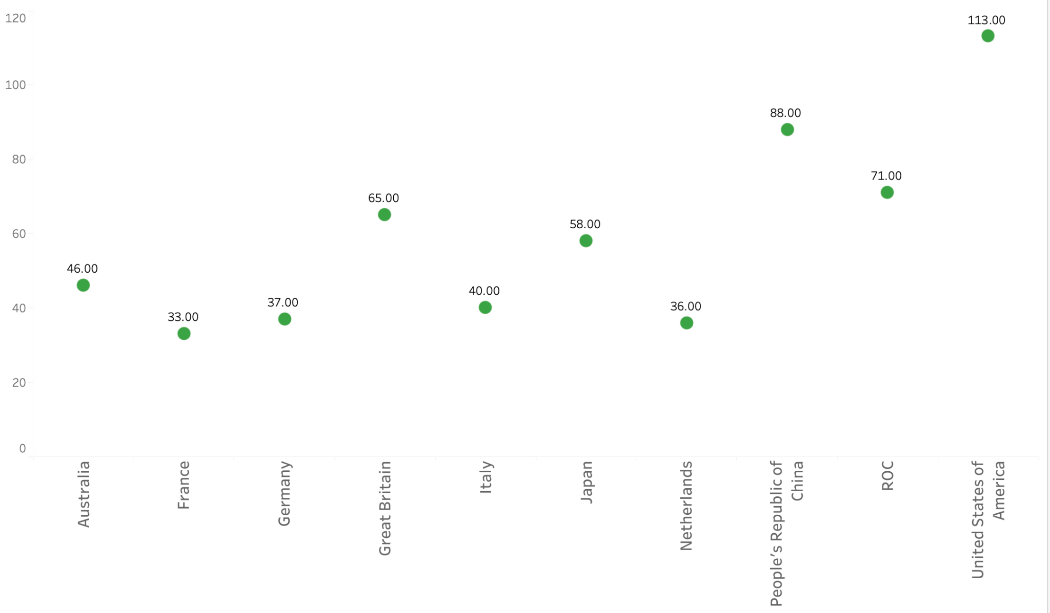
Amount is nothing but numerical values which could be represented for a set of categories.
for example the amount/number of medals each country won in the Olympics. We can see that USA has won the highest number of medals that is 113. 113 is the amount here.
Amounts

Slide 8
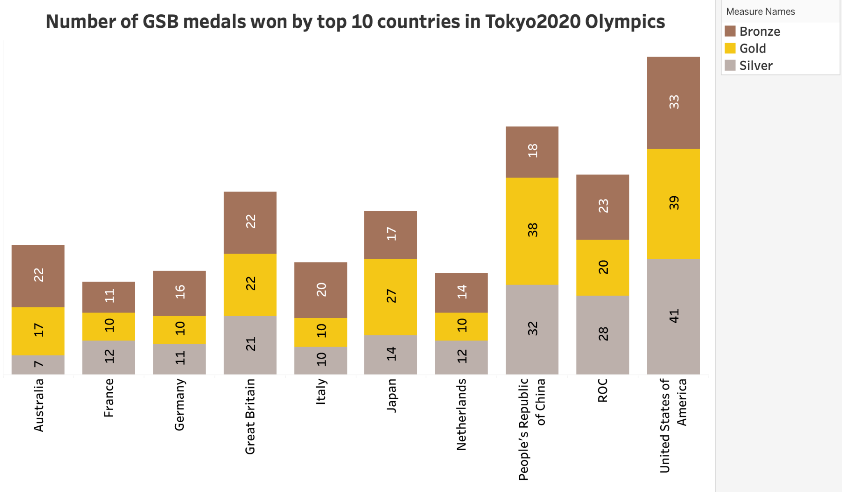
Amounts
The amount can also be represented for two or more sets of categories, if we elaborate on the same example here the type of medal is one category and set of countries are one category
We can see the number of medals won by each country in each category. We can also observe each country has won more bronze medals when compared to gold and silver medals.

Slide 9
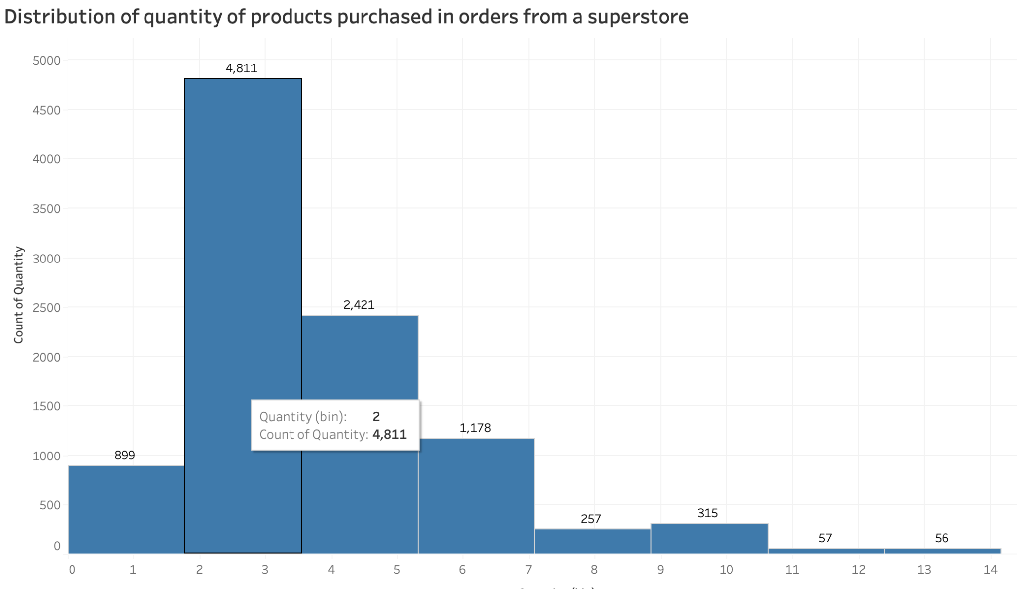
Distributions
When the data is spread out over its possible range of values then we can say that the data is distributed.
Histograms and density plots provide the most intuitive visualizations of a distribution
Cumulative densities and quantile-quantile (q-q) plots always represent the data faithfully but can be more difficult to interpret
We can see the distribution of quantity of products ordered in this histogram chart.
We can see that the orders with 2 items are the highest ordered from this distribution
We can also see that orders with 14 items is the least ordered

Slide 10
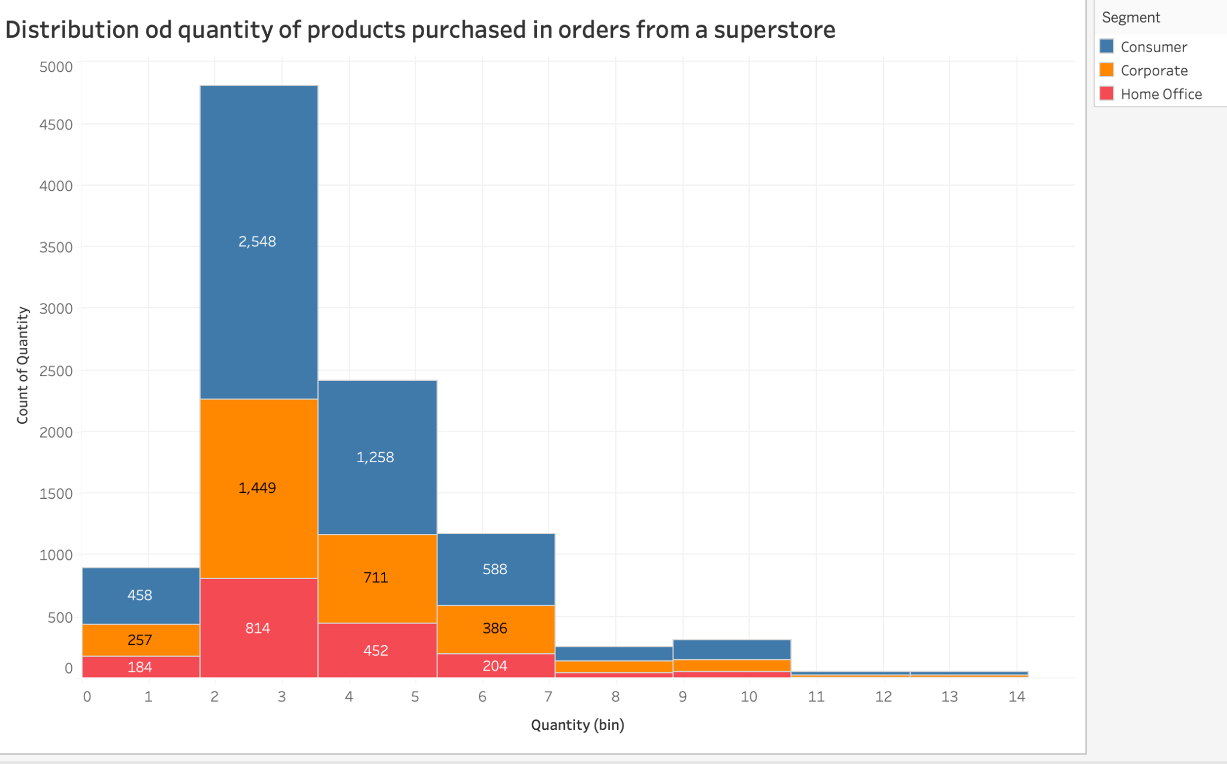
Distributions
Stacked histograms and overlapping densities, on the other hand, are more suitable when the goal is to compare a smaller number of distributions in greater depth.
Ridgeline plots are a newer technique that can be useful when comparing large numbers of distributions or tracking changes in distributions over time.
We can see the details of the order and purchase distribution from the stacked histogram w.r.t customers, Corporate and Home office.
We can observe that customers have the highest distribution and they have ordered most .
Home office has the least distribution and they have made least orders

Slide 11
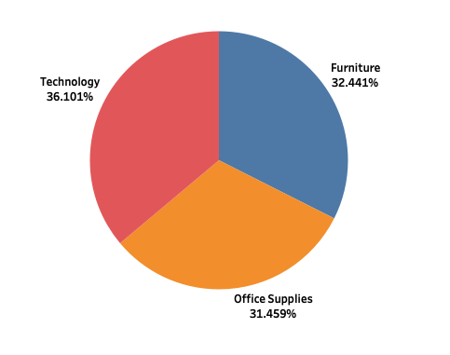
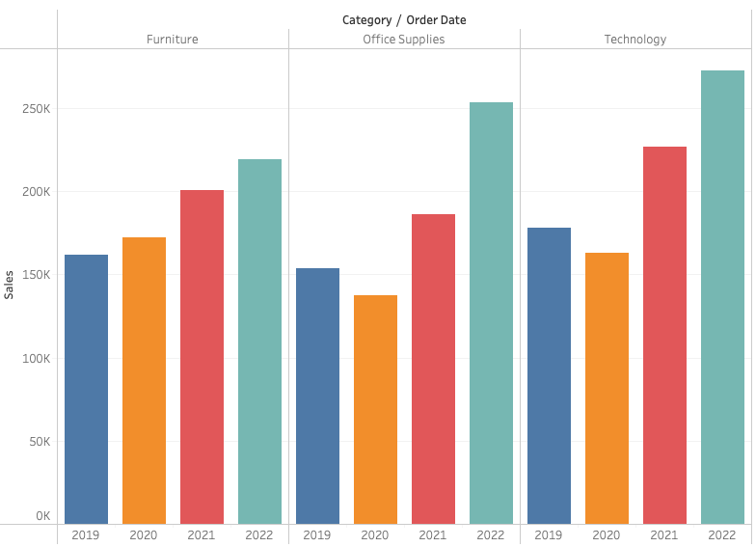
Proportions
There can be different type of charts used for proportions based on whether the data is Continuous or Discrete.
In Pie chart, technology contributes the highest to sales, all the three departments contribution is similar.
In Grouped bar chart, Sales contribution follows similar trend across different years.

Slide 12
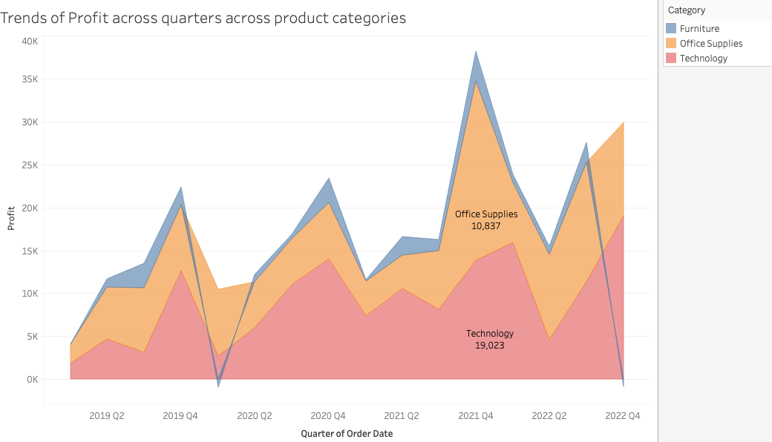
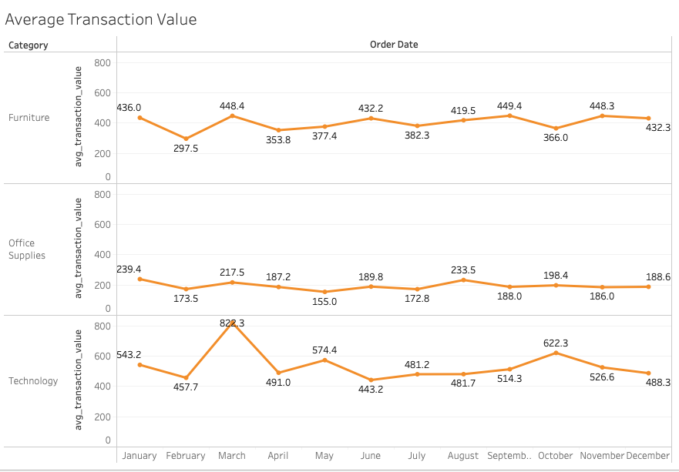
Below Area chart shows continuous distribution over different quarters across different categories.
Below Line chart depicts the average transaction value based on the sales/order and the calculated measure is shown across different time periods.
Proportions with Continuous Data

Slide 13
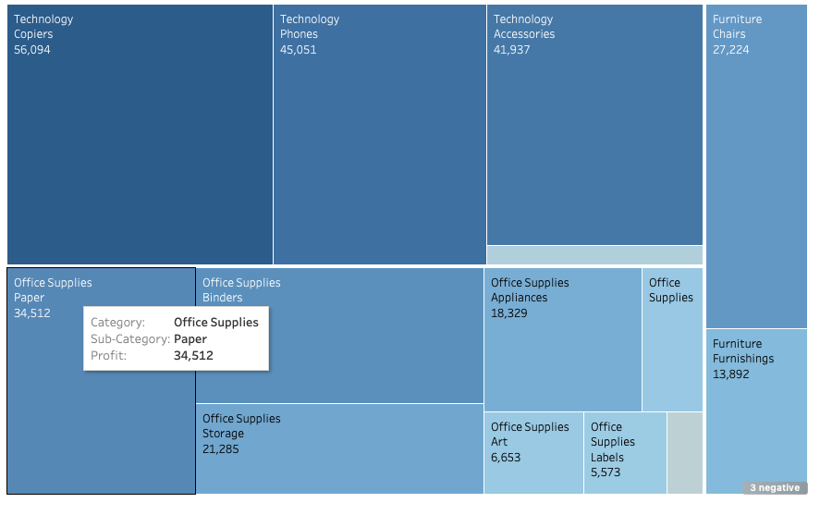
Proportions
Treemaps in Tableau has the origins of mosaic plots.
In general, Mosaic plots assume that any group variable can be combined, whereas treemaps do not make this assumption.
For heatmap, we can combine more than one grouping variable type and portray the picture, level of sales category and subcategory.

Slide 14
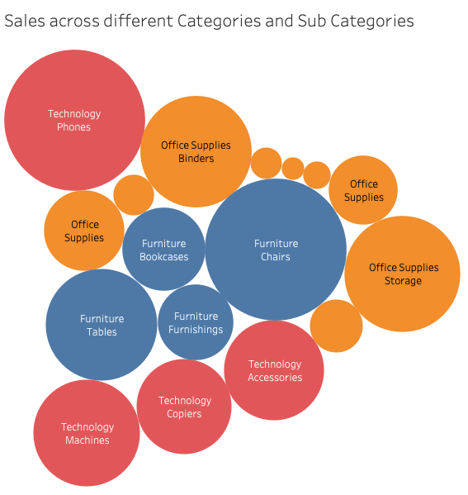
Proportions
Bubble Stacked Chart
Represents the same data as previous slide.
This chart type has its roots in Treemaps chart visualization which has been discussed in the previous slide.
The similar sub categories (which belong) to the same category are of same color, unlike Treemaps.
The given chart explains many different grouping variables that can be visualised through different colors and each category and its sub categories have same color depiction throughout.

Slide 15
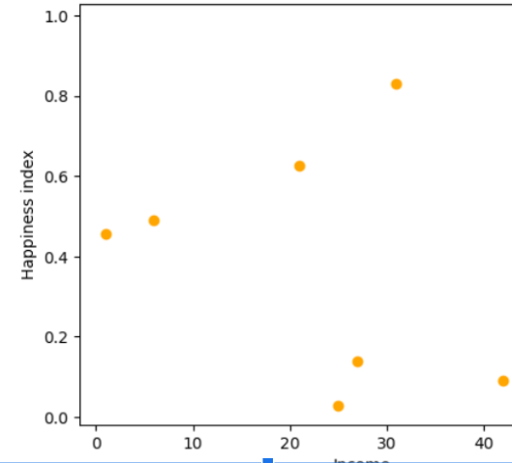
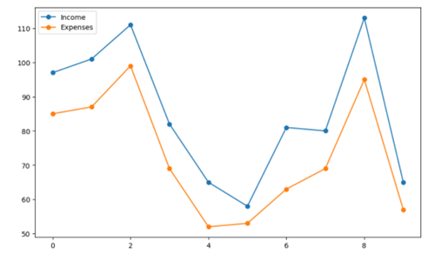
X-Y relationships
x-y relationship visualization is representing variables x, y axis and visualizing how one variable varies with respect to another.
J
The chart is a scatter plot of how happiness index is changing with respect to changing income. Here we can see happiness indexes increases with income. And after certain income, happiness index varies even if income increases.
The connected scatter chart represents income and expense of a person. Here we can two variables can be compared. We can see expense of person every month is less than income of a person.

Slide 16
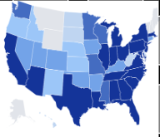
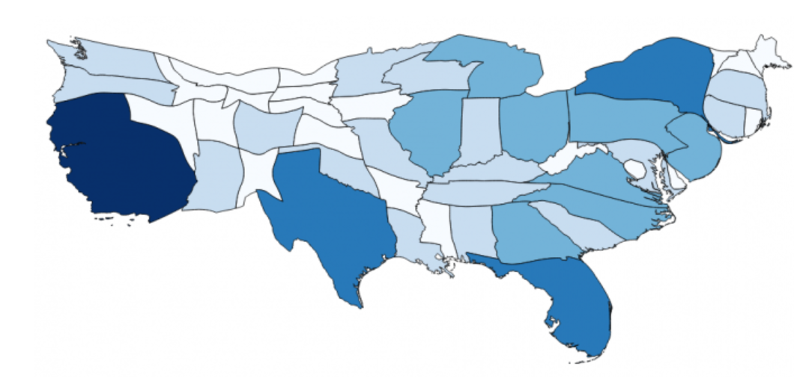
Geospatial data
Geospatial data is represented in the form of maps. A map takes coordinates on the globe and projects them onto a flat surface.
Here both the chart represents the population of united states. Here first chart represents choropleth where each states are colored by different shades of blue.
Second chart represents cartogram where first chart is distorted according to population of each state. We can see Florida state is big in second chart compared to first chart.

Slide 17
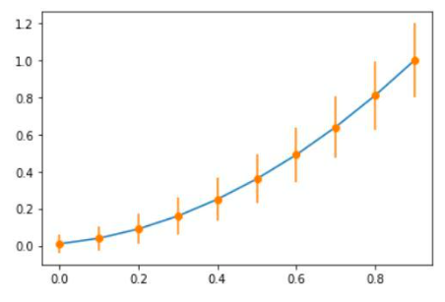
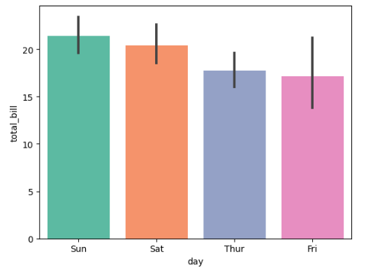
Uncertainty
Uncertainty is the quantitative estimation of error present in data.
The below Error bars depicts the range of likely values for an estimate.

Slide 18
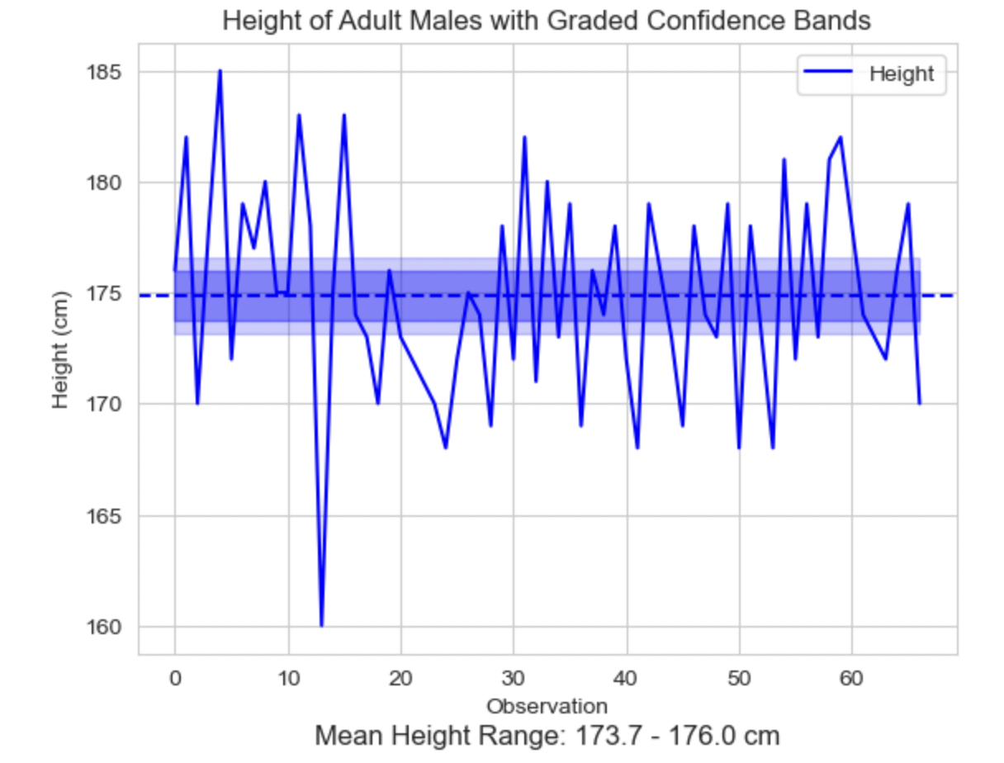
Confidence Band
Estimated using Confidence interval of 95% Mean height range is between 173.6 to 176 where the confidence band lies
the shaded blue area around the line shows the confidence bands
darker blue shade means we are more confident in our estimates and the lighter blue shade means we are less confident

Slide 19
References
These references are used for Distribution plots
https://en.wikipedia.org/wiki/Box_plot
https://rpubs.com/crazyhottommy/sina-plot
https://www.statology.org/ggplot-density-plot-overlay/
https://www.data-to-viz.com/graph/ridgeline.html
These references have been used while creating the Geospatial visualizations and correlogram in the presentation.
https://gisgeography.com/cartogram-maps/
https://rpubs.com/zachsilvey/332155
https://www.geeksforgeeks.org/visualize-correlation-matrix-using-correlogram-in-r-programming/

